Slide 1
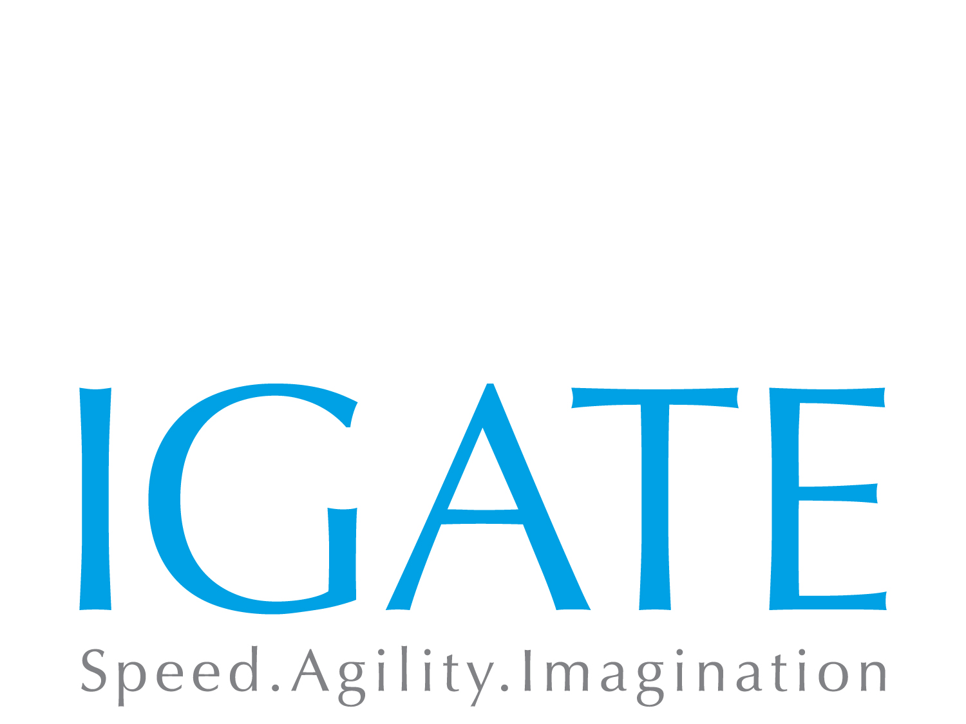
RESTful Web Services with Java
Notes:
Copyright © 2011 IGATE Corporation. All rights reserved. No part of this publication shall be reproduced in any way, including but not limited to photocopy, photographic, magnetic, or other record, without the prior written permission of IGATE Corporation.
IGATE Corporation considers information included in this document to be Confidential and Proprietary.

Slide 2

Course Goals and Non Goals
Course Goals
Learning core concepts of RESTful Web Services
Developing applications using JAX-RS ( Jersey and Apache CXF)
Course Non Goals
Developing Enterprise applications

Slide 3
Pre-requisites
Java 1.5
HTML/XML/JSON
AJAX
Web Service
Tools
Eclipse
Jboss / Tomcat

Slide 4

Intended Audience
Developers/Programmers

Slide 5
Day Wise Schedule
Day 1
Lesson 1: Introduction to RESTful WS
Lesson 2: Resource Representation with JAX-B
Lesson 3: Introducing JSON
Lesson 4: JAX-RS Implementation
Lesson 4: REST and SOAP comparison

Slide 6
Table of Contents
Lesson 1: Introduction to RESTful WS
Introduction to Webservice
REST as Lightweight Web Services
REST Architecture Components
Lesson 2: Resource Representation with JAX-B
Resource Representation using JAX-B
Standard annotations and Content negotiation for XML and JSON
Lesson 3: Introducing JSON
REST Server Responses
Introduction to JSON
REST with AJAX

Slide 7
Table of Contents
Lesson 4: JAX-RS Implementation
Build REST web services using JAX-RS ( Jersey, Apache CXF)
Build REST web services using Spring
Introduction to RESTlet
Testing of REST Services
Lesson 5: REST and SOAP comparison
REST vs. SOAP
WSDL and WADL
Design Guidelines for a REST architecture

